Slide 1



ADDA DISCOVERY
Project
Done by
Edima & Balqees Almashjari

Slide 2


Scenario and issue of the Project:
Managers want an insight of statistics of two sectors ( health and Tourism in UAE in years 2019-2020 to make an overview and new strategy of those sectors for 2030.

Slide 3
Solution:
Make an insight with statistics and overview of those two sectors that make a right , quick and easy decision for the managers .

Slide 4
Project Steps:
Select datasets match to the target from https://addata.gov.ae/search/type/dataset
Make a decision to confirm the tools/ application that will be used to build this project
Analysis the data(clean, make relationship)
Visualize data and represent to the management using R shiny and Power BI applications

Slide 5
Health Sector insight: ( created by: Edma)

Slide 7
Tourism Sector insight: (created by Balqees)
The Datasets have selected are :
Total Guests by Purpose of Visit, Year and Quarter table
Hotel Revenues, Occupancy, length of stay and Guests by Stars Rating , Year and Quarter Table.
Number of Hotels and Rooms by City, Year and Quarter

Slide 8
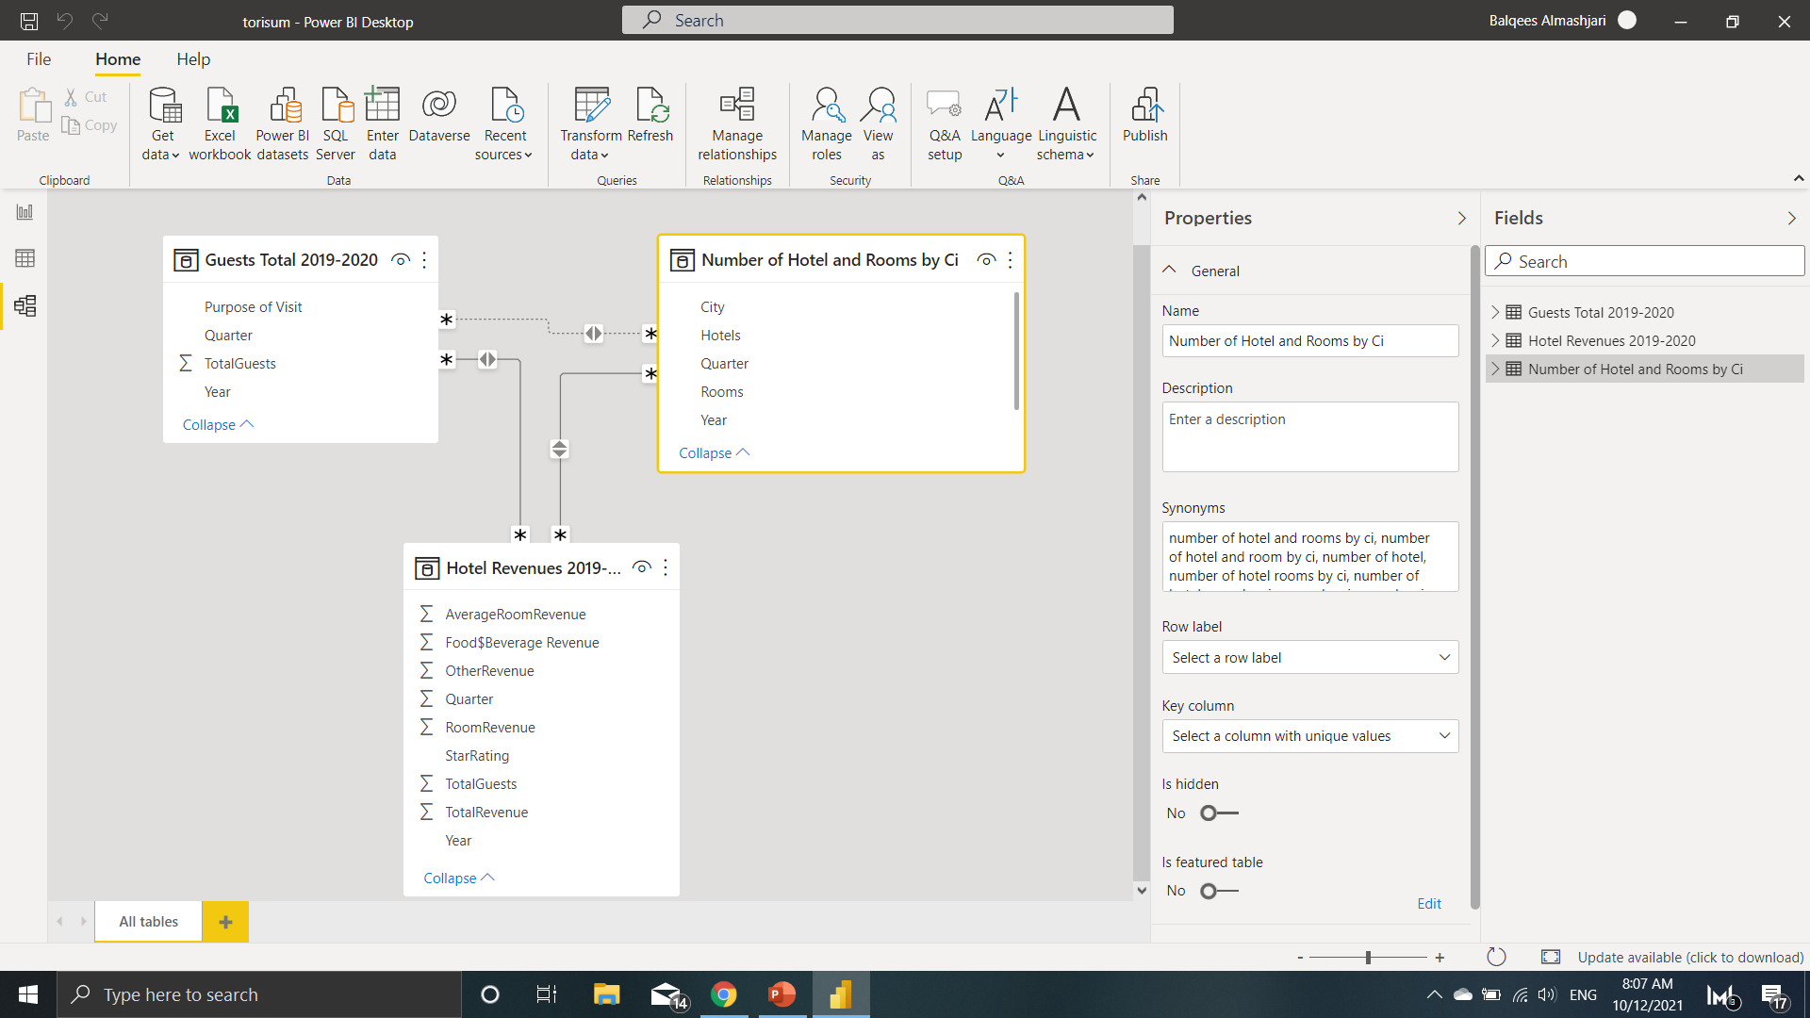
Tables with Relationship
Insight screenshot

Slide 9
Overall project insight
Here put the web url of our project

